Slide 1
Predictive maintenance of industrial machinery
CAPSTONE PROJECT
Presented By:
1.Dendi Priyanka Reddy-Maturi Venkata Subba Rao Engineering College-ECE

Slide 2
OUTLINE
Problem Statement (Should not include solution)
Proposed System/Solution
System Development Approach (Technology Used)
Algorithm & Deployment
Result (Output Image)
Conclusion
Future Scope
References

Slide 3
Problem Statement
Develop a predictive maintenance model for a fleet of industrial machines to anticipate failures before they occur. This project will involve analyzing sensor data from machinery to identify patterns that precede a failure. The goal is to create a classification model that can predict the type of failure (e.g., tool wear, heat dissipation, power failure) based on real-time operational data. This will enable proactive maintenance, reducing downtime and operational costs.

Slide 4
Proposed Solution
The proposed system aims to anticipate machine failures in advance by analyzing operational sensor data using machine learning. This enables proactive maintenance and reduces downtime. The solution includes the following components:
Data Collection:
Gather historical and real-time sensor data from industrial machines.
Use features such as temperature, torque, vibration, and tool wear.
Use the Kaggle dataset for initial model development.
Data Preprocessing:
Clean and preprocess the data to handle missing values and outliers.
Perform feature engineering and normalization to enhance model accuracy.
Encode categorical variables where required.
Machine Learning Algorithm:
Use classification algorithms like Random Forest or XGBoost.
Train the model to predict failure types (e.g., tool wear, heat dissipation, power failure).
Apply cross-validation and hyperparameter tuning for better performance.

Slide 5
Proposed Solution
Deployment:
Use IBM Watson Studio for model training and evaluation.
Store data in IBM Cloud Object Storage.
Deploy the model using IBM Watson Machine Learning as a REST API.
Integrate the API into a simple dashboard or monitoring system.
Evaluation:
Model performance is assessed using: Accuracy, Precision & Recall, F1 Score, Confusion Matrix.
Cross-validation confirms the model’s robustness and generalization.
Periodic retraining with new data is recommended for continuous improvement.
Result:
The model successfully predicts machine failure types based on sensor data.
Example Output:
Input: Temperature = 70.5, Torque = 45.1, RPM = 1600
Prediction: Tool Wear

Slide 6
System Approach
This section outlines the tools, technologies, and environment used to develop and deploy the predictive maintenance system.
System Requirements:
Platform: IBM Cloud Lite
Development Tool: IBM Watson Studio
Storage: IBM Cloud Object Storage
Deployment: IBM Watson Machine Learning
Hardware: 64-bit OS, 4 GB+ RAM, stable internet connection
Libraries Required:
pandas, numpy – Data preprocessing and manipulation
scikit-learn – Machine learning model development
xgboost – Advanced classification (optional)
matplotlib, seaborn – Data visualization
ibm_watson_machine_learning – Model deployment on IBM Cloud

Slide 7
Algorithm & Deployment
Algorithm Selection:
Selected Random Forest Classifier due to its robustness, high accuracy, and ability to handle complex nonlinear relationships.
Suitable for classification tasks with mixed data types (numerical + categorical).
Helps in identifying key features contributing to machine failures.
Data Input:
Input Features Used: Product Type (categorical), Air temperature [K], Process temperature [K], Rotational speed [rpm], Torque [Nm], Tool wear [min]
Target Variables: Target – Binary outcome (0: No failure, 1: Failure) Failure Type – Multi-class label for specific failure types (e.g., Tool Wear, Power Failure, etc.)

Slide 8
Algorithm & Deployment
Training Process:
Preprocessing: Cleaned data, encoded categorical features (e.g., product type), and scaled numerical values.
Train-Test Split: Divided data into training and test sets (typically 80/20 split).
Model Selection: Chose a Random Forest Classifier due to its effectiveness in handling complex, multi-class problems.
Model Training: Trained the model using sensor and operational features to learn patterns related to different failure types.
Parameter Setup: Used default or manually selected parameters initially (no advanced tuning at this stage).
Prediction Process:
Input: The trained model receives real-time or historical machine sensor data (e.g., air temperature, rotational speed, torque, tool wear).
Inference: The model analyzes the input features to detect patterns associated with known failure types.
Output: It predicts the type of machine failure (e.g., Tool Wear, Heat Dissipation, Power Failure) or identifies no failure.
Real-Time Use: This prediction can be integrated into a live dashboard or alert system for proactive maintenance scheduling.
Automation: Can trigger alerts or maintenance actions automatically, reducing unexpected breakdowns and operational downtime.

Slide 9
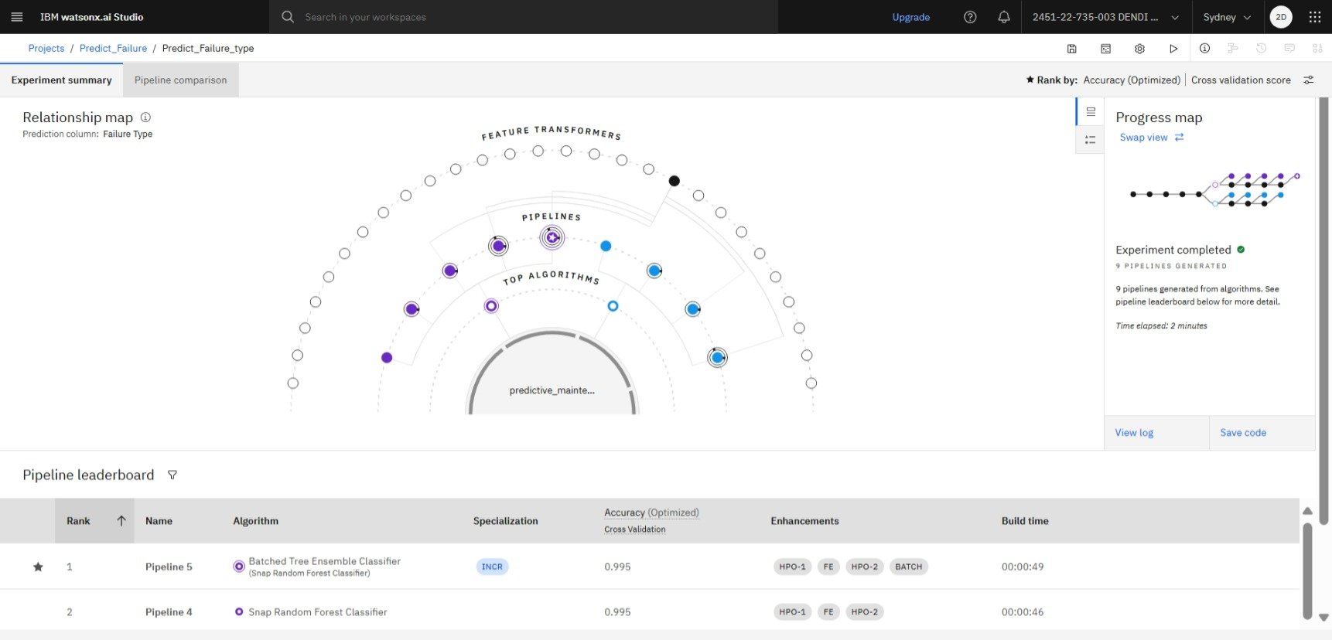
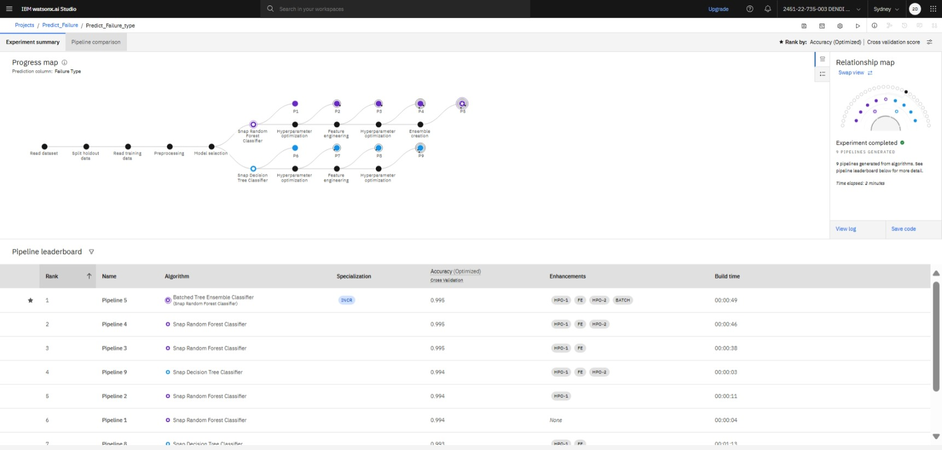
Result

Slide 10
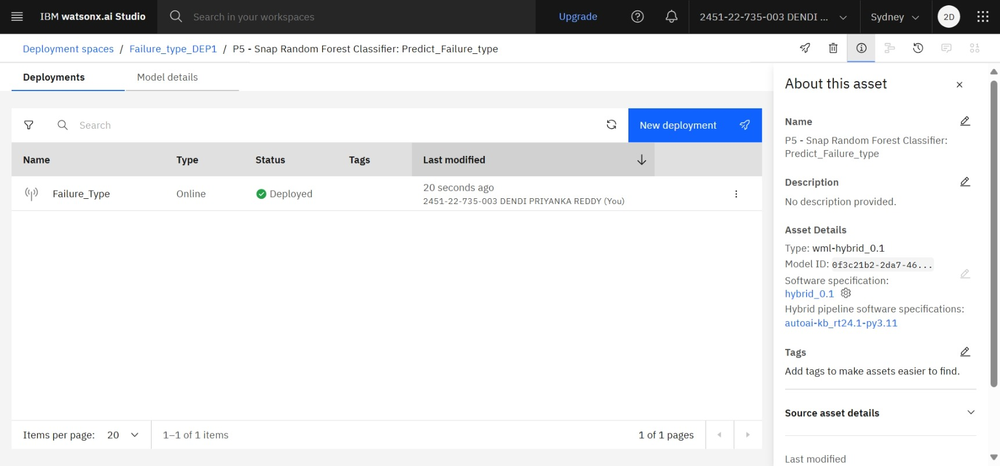
Result

Slide 11
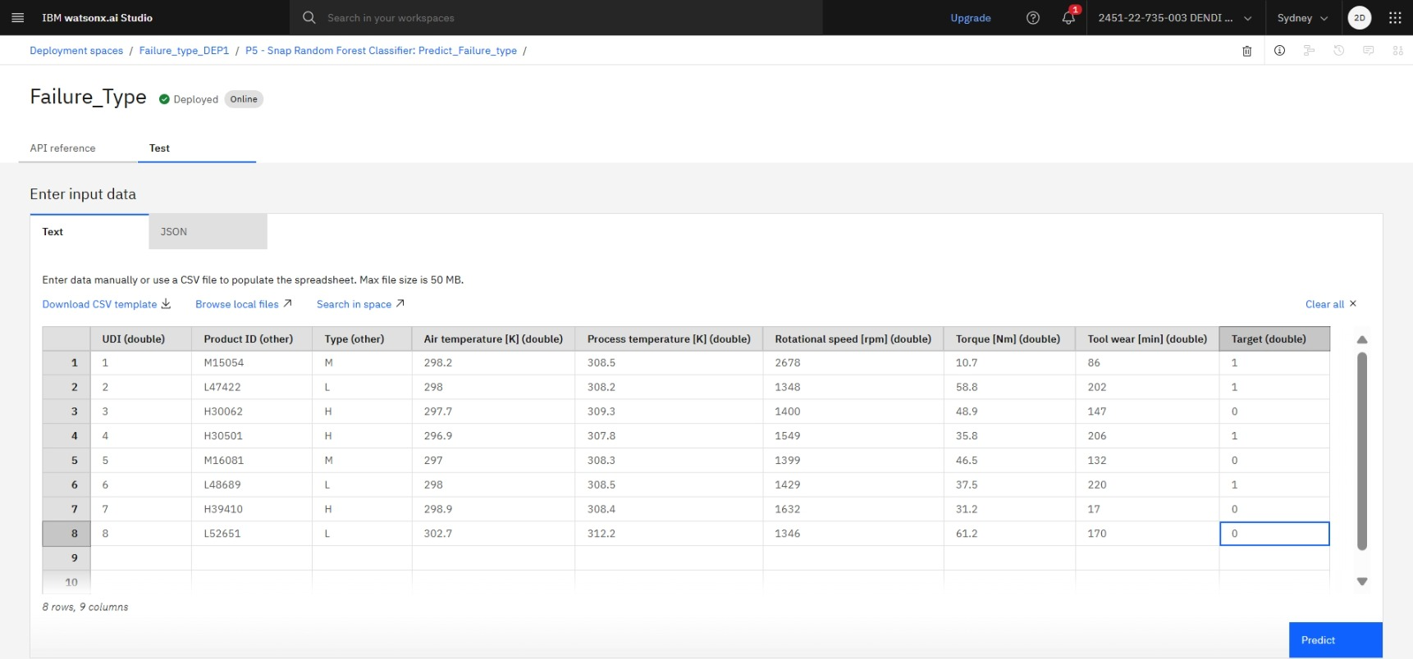
Result

Slide 12
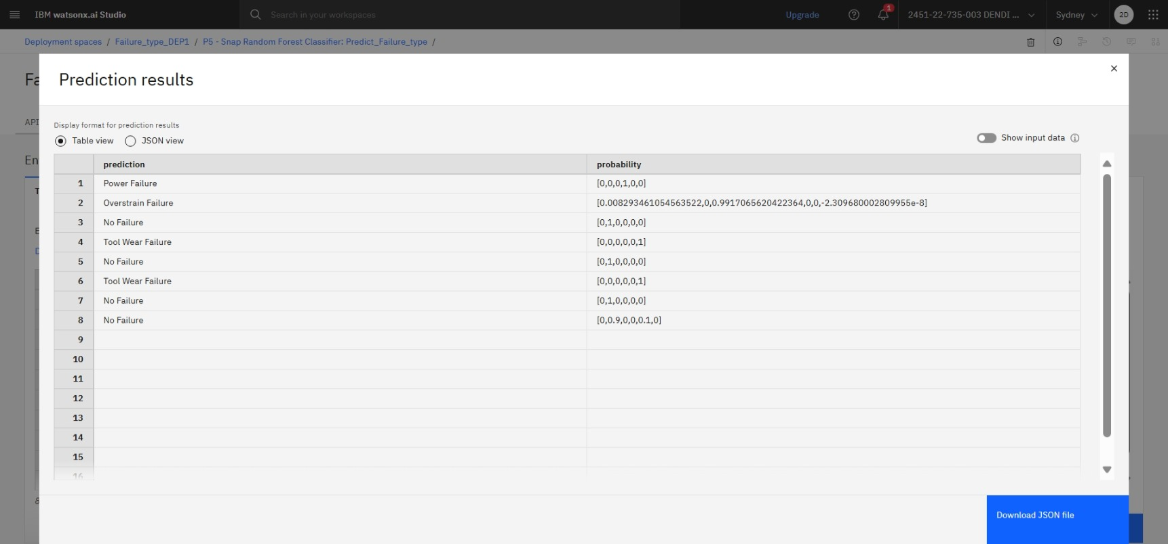
Result

Slide 13
Conclusion
The project effectively used machine learning techniques to predict equipment failures before they occur.
The model successfully classified different types of failures, supporting proactive maintenance strategies.
Key challenges included handling data imbalance and selecting meaningful features from sensor readings.
Despite these challenges, the model achieved promising results and showed potential for real-time deployment.
Accurate failure prediction is crucial for minimizing downtime, reducing costs, and improving the overall efficiency of industrial operations.

Slide 14
Future scope
Integration of Additional Sensors: Incorporate more diverse sensor data (e.g., vibration, temperature gradients) to improve failure prediction accuracy.
Algorithm Optimization: Enhance model performance using advanced ML techniques such as ensemble methods or deep learning models.
Real-time Monitoring with Edge Computing: Deploy models on edge devices for faster, on-site failure detection and response.
Scalability Across Industries: Extend the system to other industrial sectors with similar predictive maintenance needs.
Predictive Maintenance-as-a-Service (PMaaS): Develop a scalable cloud-based solution that can be adapted by multiple organizations.

Slide 15
References
Kaggle Dataset – Machine Predictive Maintenance Classification https://www.kaggle.com/datasets/shivamb/machinepredictive-maintenance-classification
Scikit-learn Documentation – Used for implementing machine learning models https://scikit-learn.org/stable/documentation.html
Pandas Documentation – For data preprocessing and analysis https://pandas.pydata.org/docs
Matplotlib/Seaborn Documentation – For data visualization https://matplotlib.org/stable/index.html https://seaborn.pydata.org/
IBM Cloud Docs (for deployment and testing on IBM Cloud) https://cloud.ibm.com/docs

Slide 16
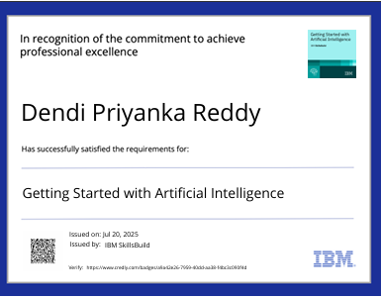
IBM Certifications

Slide 17

IBM Certifications

Slide 18
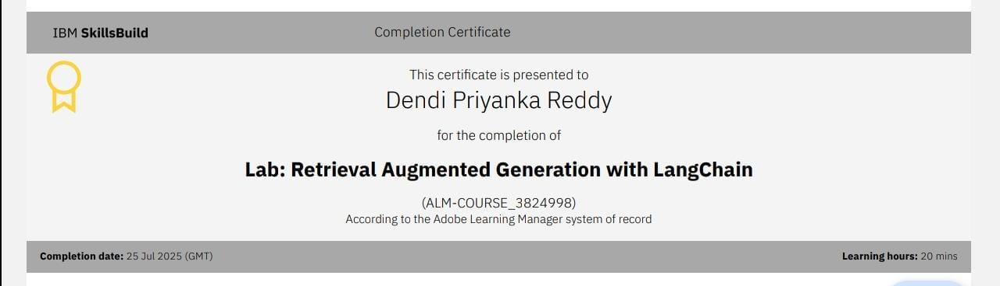
IBM Certifications

Slide 19
THANK YOU

